Slide 1

Synopsis Presentation
For the partial fulfillment of the requirements for the degree of
Bachelor of Technology
in
Robotics and Automation
Design and Development of Mobile Turret
Aarya Misal (21070127015)
Dhruv Arora (21070127072)
Saksham Galhotra (21070127042)
Tanish Nallamothu (22070127503)
Dr. Aniket Nargundkar
Symbiosis Institute of Technology, Pune
2024-25

Slide 2
Content of Presentation
Introduction (1-2 Slide)
Review of Literature (1-2 slides in tabular format)
Research Gap (1 slide)
Statement of the problem (1 slide)
Objectives of the study (1 slide)
Methodology, tool, techniques (3 to 4 slides including the objective wise flow chart of the proposed work)
Preliminary work and results (if applicable) (1-2 slide)
Schedule of the proposed work (1 slide)
Estimated expenditures (1 slide)
References

Slide 3
Introduction
The development of a 4-wheeled mobile turret for autonomous target detection and engagement addresses critical needs in modern security and defense operations.
This system offers continuous, precise, and rapid response capabilities, significantly enhancing security and defense operations by operating autonomously and navigating various terrains.
Advancements in computer vision and robotics integration are being applied to create autonomous systems for security and surveillance, enhancing real-time responsiveness and adaptability in dynamic environments.

Slide 4
Review of Literature
Sr. No | Author Name | Paper Title | Methodology | Remarks (Research Gaps)
1 | McMillen et al. | Vision-Enabled Robotics(2020) | Integration of vision systems in robots, focusing on object recognition, navigation, and adaptability. | Advanced vision systems still need improvements in sensor calibration and real-time processing.
2 | Shahria MT et al. | Modal Vision for Advanced Robotics(2018) | Utilization of sensor configurations (LiDAR, cameras) to provide comprehensive environmental understanding. | Limited data on the effectiveness of integrating multiple sensor types.
3 | Bermhed et al. | Turret Systems in Robotics(2019) | Integration of turret-mounted vision systems with capabilities of panning, tilting, and zooming for enhanced navigation and monitoring. | Need for further research on the integration of advanced turret designs and fire regimes.

Slide 5
Review of Literature
Sr. No | Author Name | Paper Title | Methodology | Remarks (Research Gaps)
4 | Anna Annusewicz | Incorporation of OpenCV into Robotic Platforms(2017) | Use of OpenCV for object detection, image processing, and machine learning in various robotic platforms, emphasizing scalability and modularity. | Challenges in implementing OpenCV within resource-restricted frames.
5 | Medina-Santiago A et al. | GNSS Navigation and Obstacle Avoidance in Mobile Robots(2016) | Use of GNSS navigation systems and obstacle avoidance algorithms for dynamic and efficient robotic mobility. | Limited focus on the integration of visual signals for improved navigation.
6 | Rahman et al. | Unmanned Ground Vehicle with Vision System(2021) | Design of a vehicle with wireless HD camera, radio control, Python-based GUI, and facial recognition using Haar-cascade classifiers and LBPH algorithm. | Integration challenges between camera systems and mobile chassis.

Slide 6
Research Gap
Optimizing the interaction between detection and tracking algorithms and the movement mechanisms of mobile turrets, particularly for real-time responsiveness in dynamic environments such as security and surveillance. Integrating newer hardware with software platforms and establishing reliable communication protocols between components like the Raspberry Pi controller, mobile app interface, sensors, and actuators remains challenging.

Slide 7
Statement of the Problem
Develop a four-wheeled mobile turret system capable of autonomously detecting human bodies, moving to the target, and accurately shooting. The system should integrate real-time object detection, tracking and PID control algorithms for precise movement using mecanum wheels to ensure seamless interaction between all components.

Slide 8
Objectives
To redesign and build the frame of the mobile turret.
To implement Computer Vision capabilities for real-time detection & tracking of targets.
To produce an autonomously moving mobile turret integrating the above-mentioned hardware and software aspects.

Slide 9
Methodology
Turret frame redesign
Modulate the height of the turret frame to accurately engage targets at varying altitudes.
Incorporate stability in order to mitigate recoil from the shooting of the gun and balance the turning torque of the chassis.
Object detection and tracking
Implement real time object detection to identify targets and follow them.
If the mobile turret encounters multiple targets, the turret will fire at the closest target first until the target is destroyed.

Slide 10
Methodology
Motion control
The mobile chassis will follow the target according to its position using omnidirectional movements (Forward, clockwise, anticlockwise).
Once the size of the detected frame diminishes to a predefined threshold, the mobile chassis will move in the direction of the target.

Slide 11
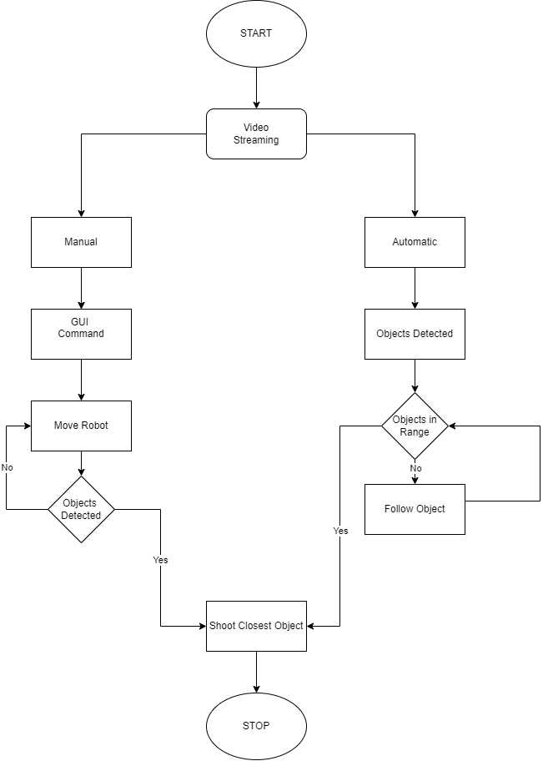
Methodology

Slide 12
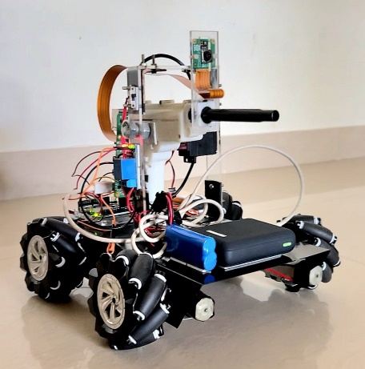
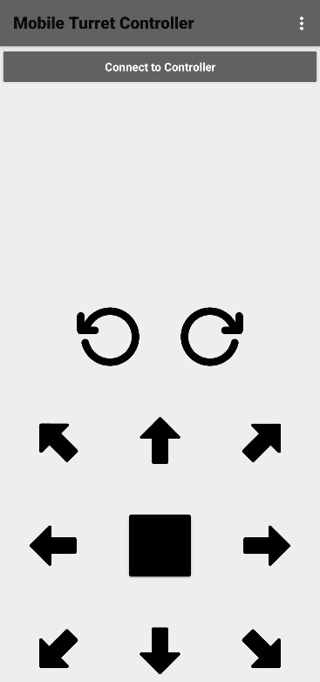
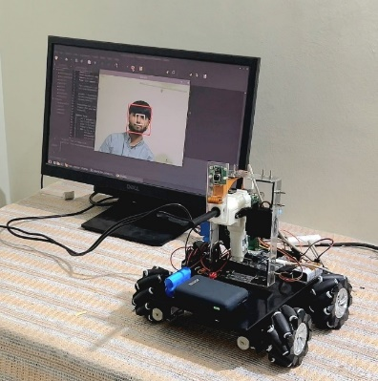
Preliminary work and Results

Slide 13
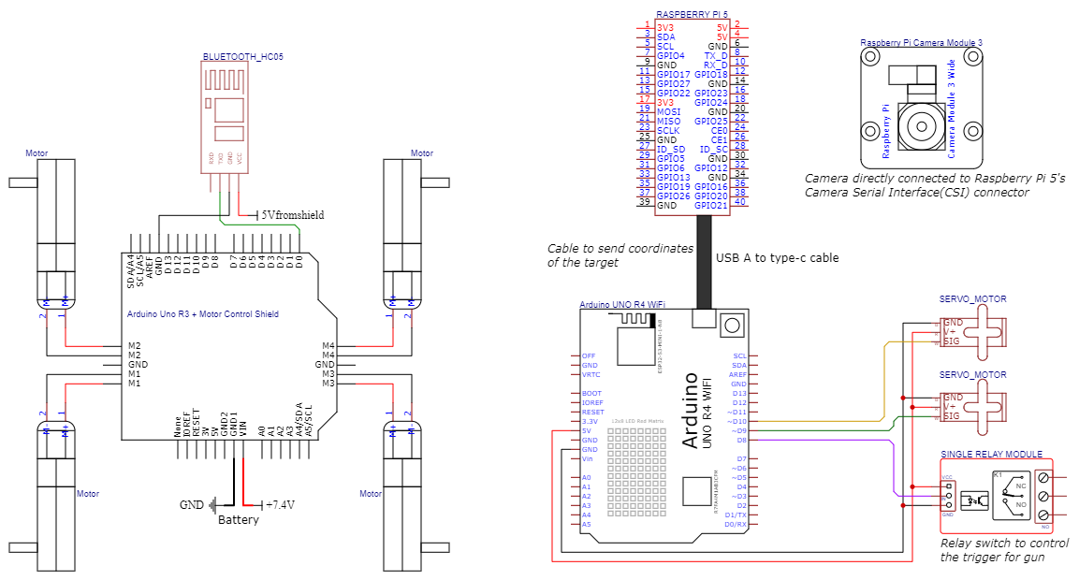
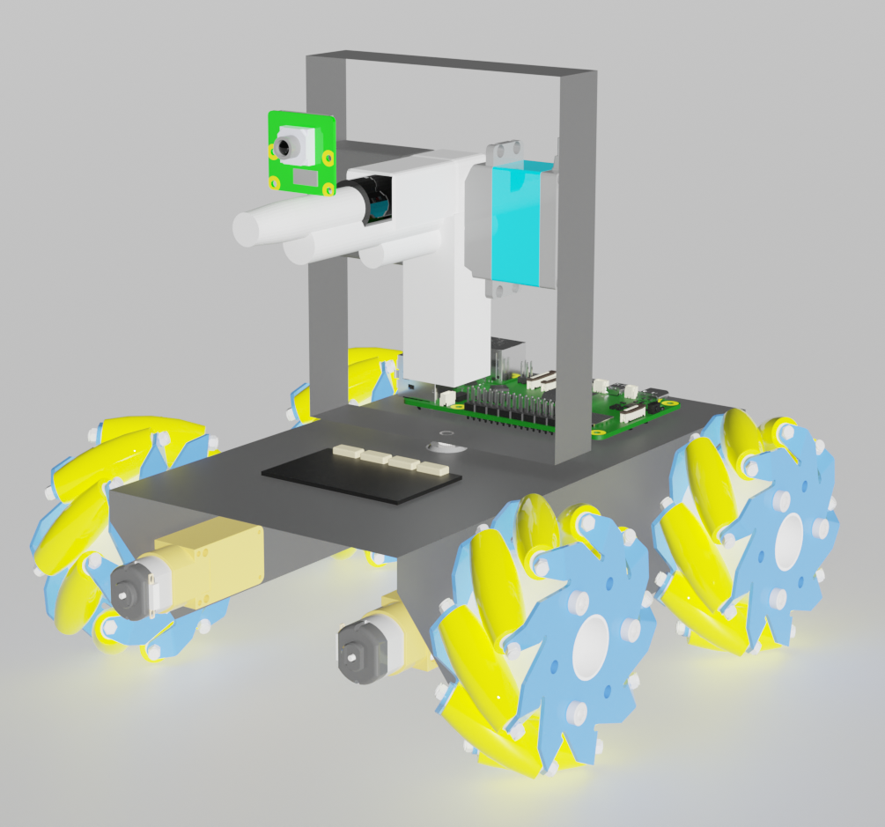
Preliminary work and Results

Slide 14
Schedule of the Proposed Work
Sr. No. | Objective | Timeline of work
 |  | 29/7 – 2/8 | 5/8 – 9/8 | 12/8 – 16/8 | 19/8 – 23/8 | 26/8 – 30/8 | 2/9 – 6/9 | 9/9 – 19/9 | 16/9 – 20/9 | 23/9 – 27/9 | 30/9 – 4/10 | 7/10 – 11/10 | 14/10 – 18/10 | 21/10 – 25/10 | 28/10 – 31/10
1 | Turret Frame Redesign
2 | Object Detection and Tracking
3 | Motion Control

Slide 15
Estimated expenditures
Sr. no. | Item | Quantity | Price (Rs.) | Amount (Rs.)
1. | Pimoroni Motor 2040 | 1 | 2050 | 2050
2. | JST SH wires | 3 | 310 | 930
3. | Raspberry Pi 5 | 1 | 8350 | 8350
4. | Encoder Motors | 4 | 500 | 2000
5. | MG996R positional servo | 1 | 250 | 250
6. | Bluetooth module HC-05 | 1 | 200 | 200
7. | Mecanum wheels (pack of 4) | 1 | 780 | 780
8. | Raspberry Pi camera module V3 | 1 | 2070 | 2070
9. | Raspberry Pi 5 camera FPC cable 300mm | 1 | 200 | 200
10. | Relay 5V | 1 | 80 | 80
11. | Battery 3.7V 2000mAh 3C Li-ion | 2 | 190 | 380
12. | Battery charger | 1 | 450 | 450
13. | Battery case | 1 | 30 | 30
14. | Power bank 10000mAh | 1 | 1000 | 1000
15. | Chassis | 1 | 330 | 330
Total: |  |  |  | 19100

Slide 16
References
Anna Annusewicz, The use of vision systems in the autonomous control of mobile robots equipped with a manipulator, Transportation Research Procedia, Volume 40, 2019, Pages 132-135, ISSN 2352-1465, https://doi.org/10.1016/j.trpro.2019.07.022.
Anwar, Muhamad & Muhajir, Muhammad & Sutoyo, Edi & Afakh, Muhammad & Risnumawan, Anhar & setyo purnomo, Didik & Suryawati, Endah & Darojah, Zaqiatud & Darmawan, Adytia & Tamara, Mohamad Nasyir. (2018). Deep Features Representation for Automatic Targeting System of Gun Turret. 107-112. 10.1109/ELECSYM.2018.8615541.

Slide 17
References
Bermhed, C., & Holst, J. (2023). Design and Construction of an Autonomous Sentry Turret Utilizing Computer Vision. Bachelor's Programme in Mechatronics, Stockholm, Sweden.
Bhat, Sandeep, and M. Meenakshi. "Vision Based Robotic System for Military Applications--Design and Real Time Validation." 2014 Fifth International Conference on Signal and Image Processing. IEEE, 2014.
D. Sharma and U. Chauhan, "War Spying Robot with Wireless Night Vision Camera," 2020 2nd International Conference on Advances in Computing, Communication Control and Networking (ICACCCN), Greater Noida, India, 2020, pp. 550-555, doi: 10.1109/ICACCCN51052.2020.9362981.

Slide 18
References
Design of a Vision Based Autonomous Turret. (2023). Journal of Automation, Mobile Robotics and Intelligent Systems, 16(4), 72-77. https://doi.org/10.14313/JAMRIS/4-2022/35
Ghouse, Zubair, Nishika Hiwrale, and Nihar Ranjan. "Military robot for reconnaissance and surveillance using image processing." International Research Journal of Engineering and Technology 4.5 (2017): 2395-0072.
Islamgozhayev, Talgat & Kalimoldayev, Maksat & Eleusinov, Arman & Mazhitov, Shokan & Orken, Mamyrbayev. (2016). First results in the development of a mobile robot with trajectory planning and object recognition capabilities. Open Engineering. 6. 10.1515/eng-2016-0049.

Slide 19
References
McMillen, John & Mitchell, Owen. (1985). An intelligent robot vision system for research applications.
40 - 45.10.1109/ROBOT.1985.1087366.
Medina-Santiago A, Morales-Rosales LA, Hernández-Gracidas CA, Algredo-Badillo I, Pano-Azucena AD, Orozco Torres JA. Reactive Obstacle–Avoidance Systems for Wheeled Mobile Robots Based on Artificial Intelligence. Applied Sciences. 2021; 11(14):6468. https://doi.org/10.3390/app11146468
Okarma, Krzysztof. (2020). Applications of Computer Vision in Automation and Robotics. Applied Sciences. 10. 6783. 10.3390/app10196783.

Slide 20
References
Patoliya, Jignesh, Haard Mehta, and Hitesh Patel. "Arduino controlled war field spy robot using night vision wireless camera and Android application." 2015 5th Nirma University International Conference on Engineering (NUiCONE). IEEE, 2015.
Rahman, M.Z.U.; Raza, U.; Akbar, M.A.; Riaz, M.T.; Gumaei, A.H.; Ahmad, N. Radio-Controlled Intelligent UGV as a Spy Robot with Laser Targeting for Military Purposes. Axioms 2023, 12, 176. https://doi.org/10.3390/axioms12020176
Raj, Ravi & Kos, A.. (2022). A Comprehensive Study of Mobile Robot: History, Developments, Applications, and Future Research Perspectives. Applied Sciences. 12. 6951. 10.3390/app12146951.

Slide 21
References
Shahria MT, Sunny MSH, Zarif MII, Ghommam J, Ahamed SI, Rahman MH. A Comprehensive Review of Vision-Based Robotic Applications: Current State, Components, Approaches, Barriers, and Potential Solutions. Robotics.
2022; 11(6):139. https://doi.org/10.3390/robotics11060139
Sun, Bowen, Jingjie Wei, and Xian Tang. "The optimization of object detection and localization in complex background for vision-based robot." 2020 IEEE International Conference on Integrated Circuits, Technologies and Applications (ICTA). IEEE, 2020.

Slide 22
References
Thangavelu, Yathavi & R, Ajay & P, Hariesh & J, John. (2020). Development of Auto Tracking and Target Fixing Gun using Machine Vision. 1-5. 10.1109/ICSCAN49426.2020.9262451.

